Slide 1
The Truth about Writing

Slide 2
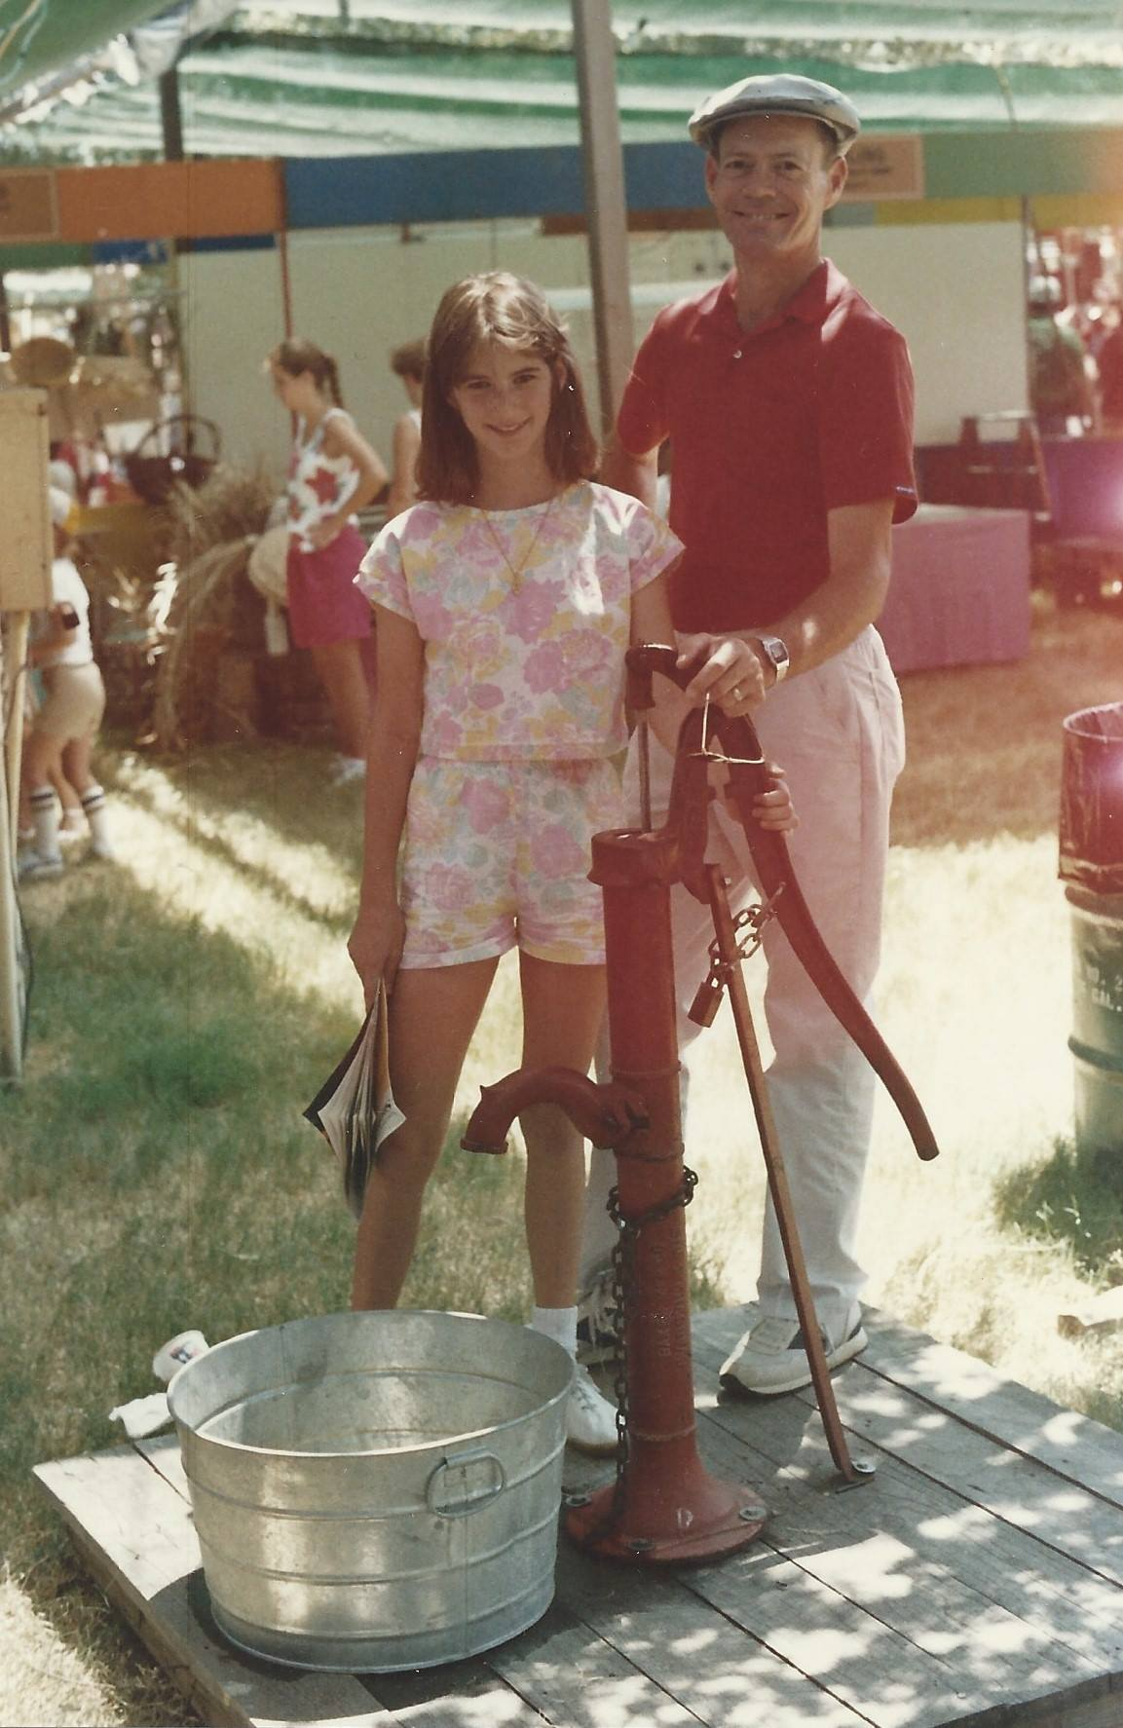
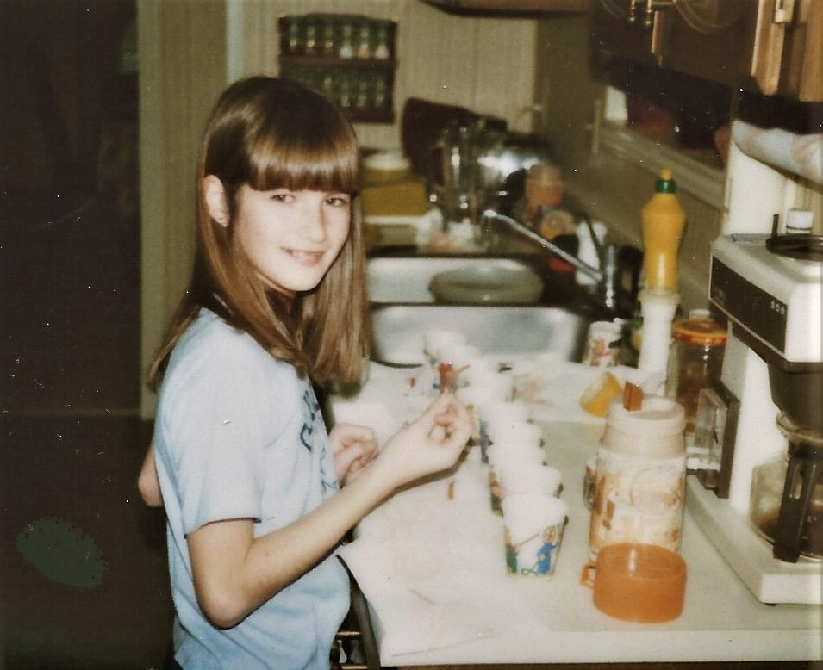
Introduction: Amy Bearce
Author, former teacher, librarian certified, story and item writer for state tests (like STAAR), & a mom to two daughters.
Notes:
Intro– Army kid, lived in Germany, married, have two kids at the Intermediate school.

Slide 3
QUICK QUIZ (Don’t worry! Everyone wins!)
True or False:
A writer has to be born with a special talent.

Slide 4
QUICK QUIZ
True or False:
A writer has to be born with a special talent.
False! A writer is someone who works at their writing, who keeps at it, and is willing to learn. Everyone can learn to be a better writer.

Slide 5
QUICK QUIZ
True or False:
A writer spends all day alone at a desk, writing straight through until the story is done.

Slide 6
QUICK QUIZ
True or False:
A writer spends all day at a desk, writing straight through until the story is done.
False! Most writers stop and start on their stories, and they often get input from other people.

Slide 7
QUICK QUIZ
True or False:
A writer experiences a lot of rejection and must be willing to learn from others.

Slide 8
QUICK QUIZ
True or False:
A writer experiences a lot of rejection and must be willing to learn from others.
True! Publishing is a tough business, and authors are often rejected many times. All stories get better with input from others.
Notes:
Most writers are not rich, and can’t make a living income from their books alone.

Slide 9
SO– what DO writers do?
Notes:
Intro– Army kid, lived in Germany, married, have two kids at the Intermediate school.

Slide 10
Writers brainstorm ideas:
You know about lots of things. You are an expert. A boss. Make a list of those things you know about.
These are good topics to start with:
Family, hobbies, pets, trips you’ve taken, sports you play

Slide 11
Writers pick a Goldilocks topic:
Not too large. Not too small. Just right.
“Soccer” is too broad a topic. Telling about my new soccer ball is probably too narrow. But I could tell a great story about my last soccer game where I scored my first goal.

Slide 12
Writers tell what happened:
I scored a goal for the first time in soccer.
Notes:
Don’t get overwhelmed. Personal narrative make writing easier to start with. Just tell what happened.

Slide 13
Writers tell more about what happened:
I scored a goal for the first time in the last soccer game of the season.
Notes:
Don’t get overwhelmed. Personal narrative make writing easier to start with. Just tell what happened.

Slide 14
Writers tell about the best part:
I scored a goal for the first time in the last soccer game of the season. We played the hardest team in the league, but we won. My coach finally let me play forward position, my favorite.

Slide 15
Writers add interesting details:
I scored a goal for the first time in the last soccer game of the year. We played the hardest team in the league, but we won. My coach finally let me play forward position, my favorite. After I kicked the ball straight into the corner of the net, I felt like my feet had wings.

Slide 16
Our turn:
We went to the park with our class.
Remember:
Tell more (Who? When? Where? Why?)
Tell about the best part.
Add interesting details.

Slide 17
Interested in Writing NOW?
13 and under for Stone Soup submissions

Slide 18
Read many excellent books!

