Slide 1
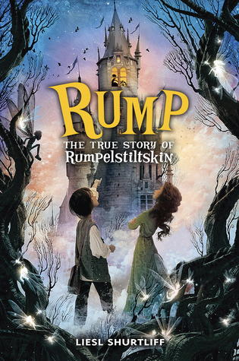
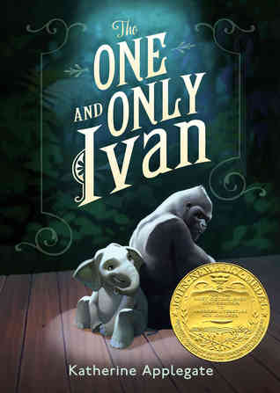
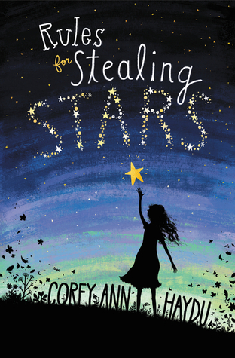
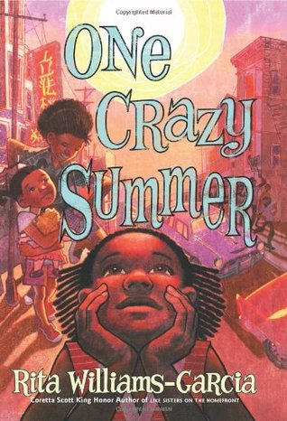
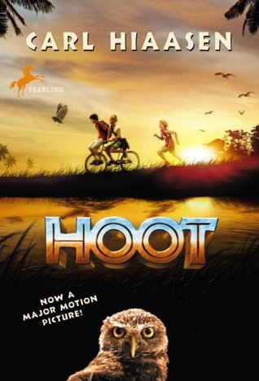
Some of my favorites for 3rd-6th

Slide 2
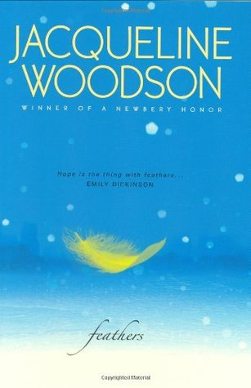
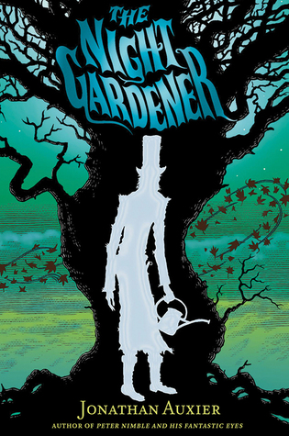
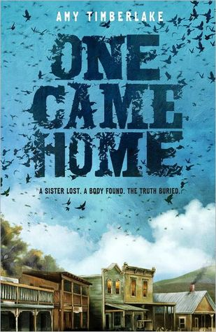
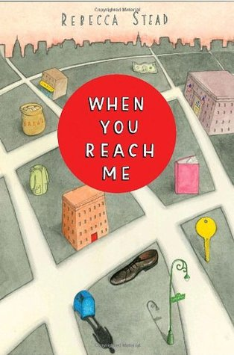
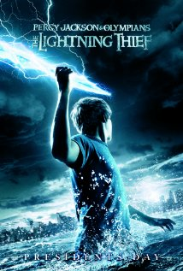
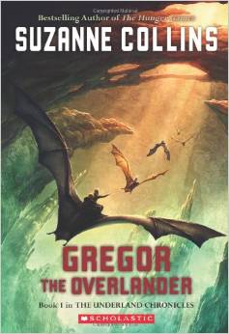
Some of my favorites for 5th-8th

Slide 3
3 Things I’ve Learned about Writing and Publishing
Amy Bearce

Slide 4
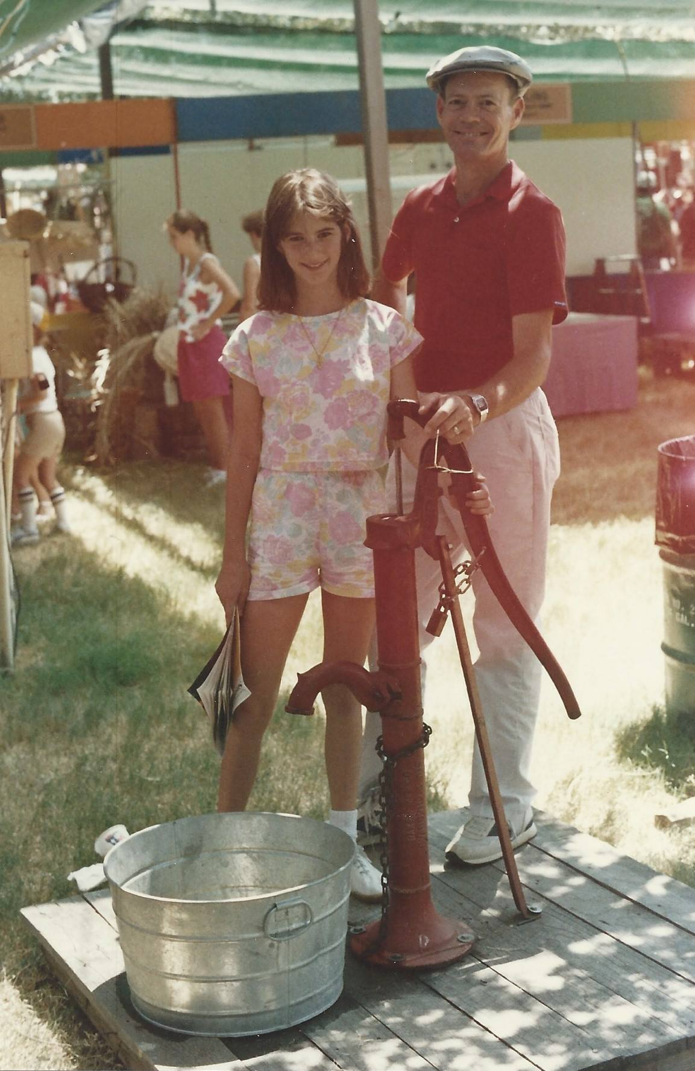
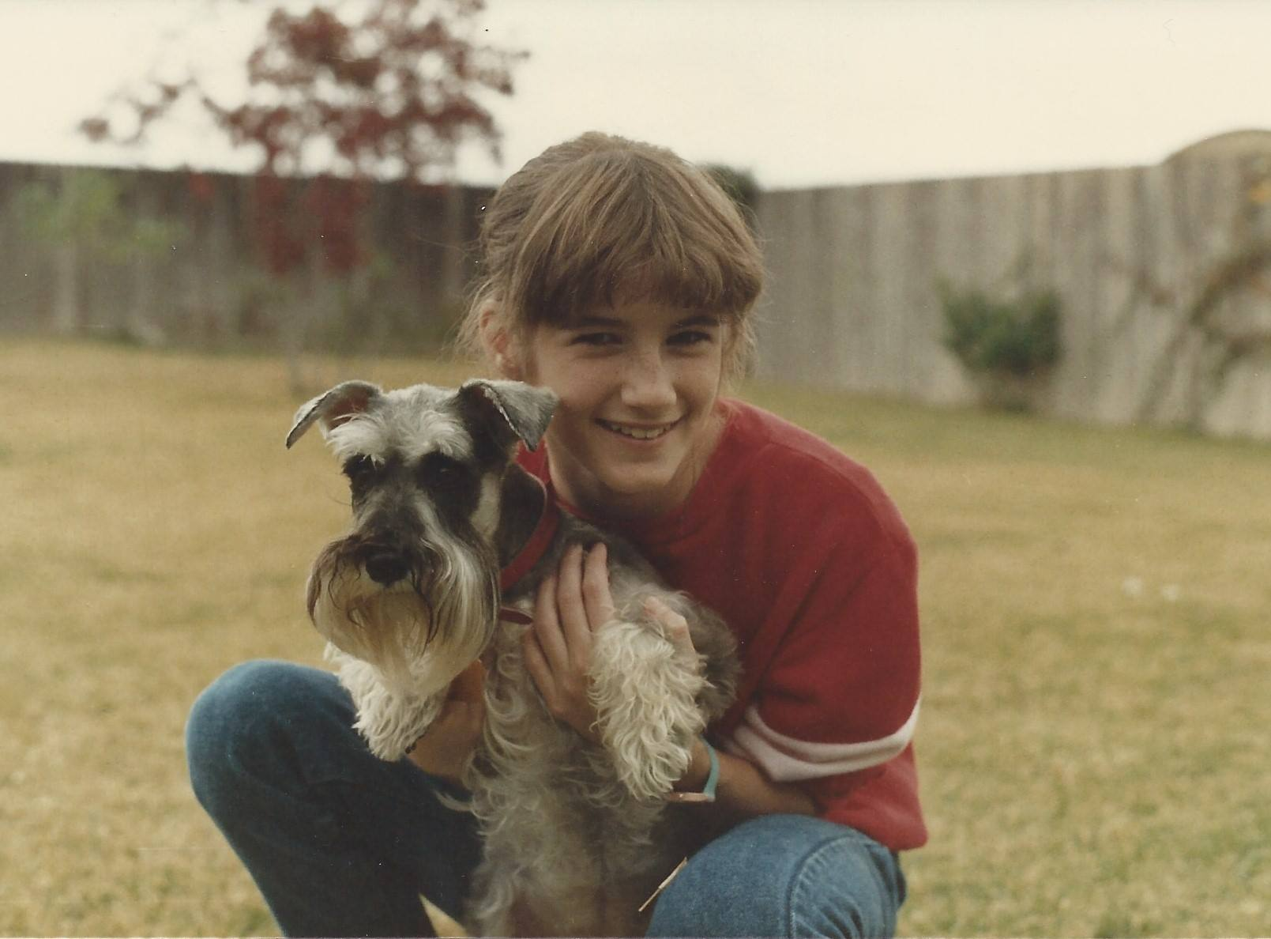
Introduction: Amy Bearce
Me in 5th, 6th and 7th grade.
Notes:
Intro– Army kid, lived in Germany, married, have two kids at the Intermediate school.

Slide 5
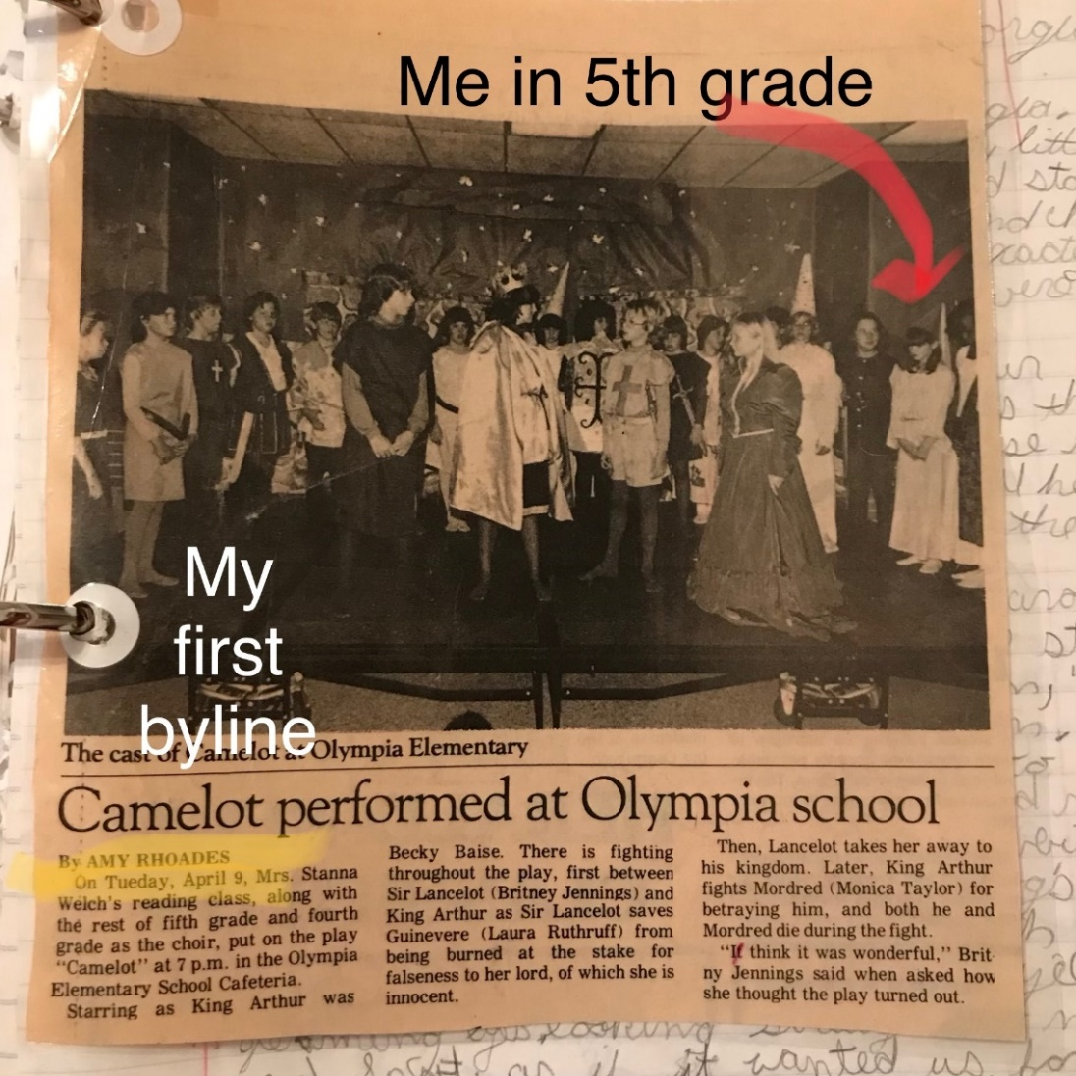
When did Amy start writing?
I Started writing in 5th grade!
But then I stopped writing…
Taught language arts to 6th-8th gr.
Short stories and articles- for years (16 of them and counting)
AND THEN…
Began writing book-length stories almost 10 years ago– as an adult!.
It’s never too late!
Notes:
My experience with writing– school, short stories for Pearson, and now.

Slide 6
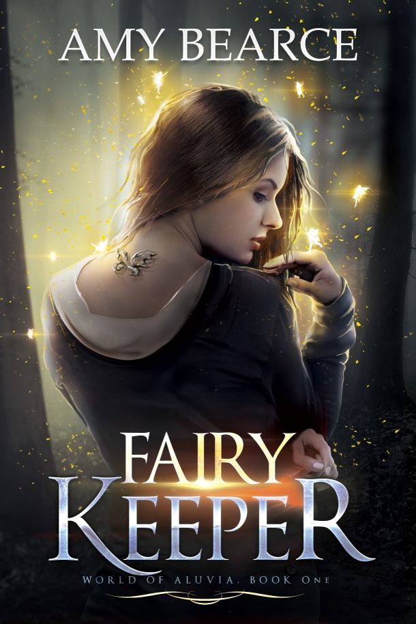
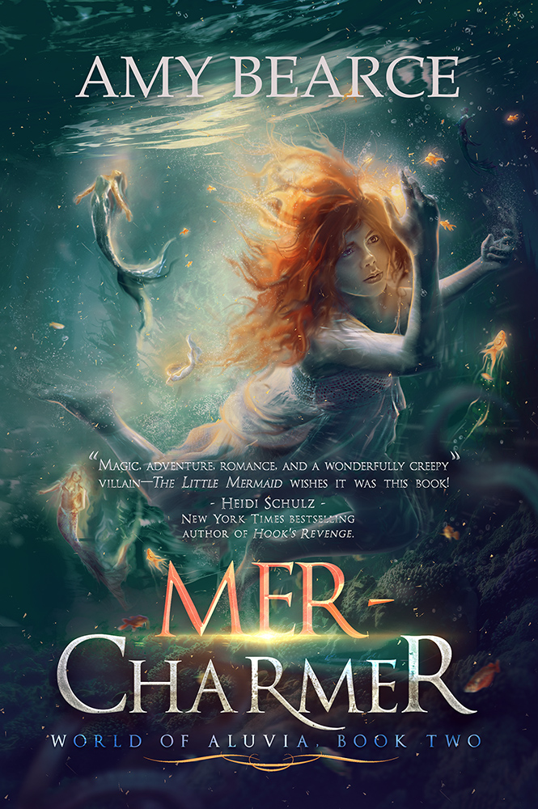
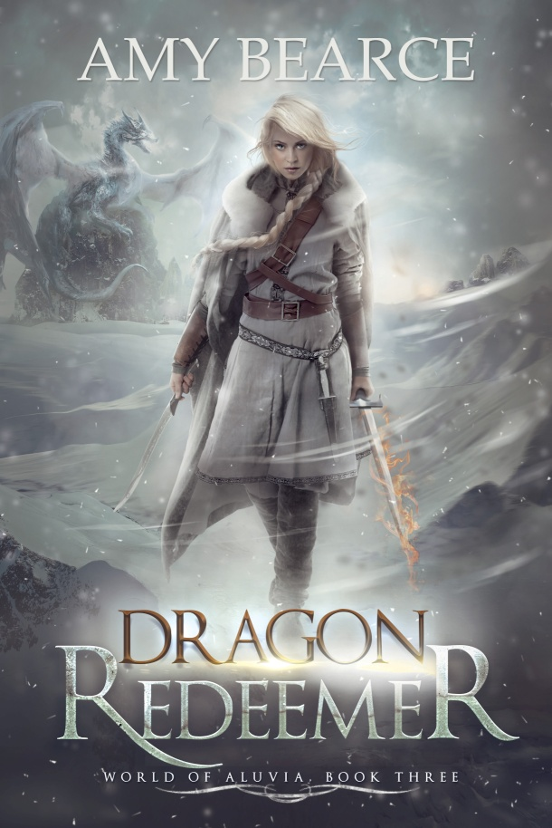
Fantasy and science fiction
The World of Aluvia series

Slide 7
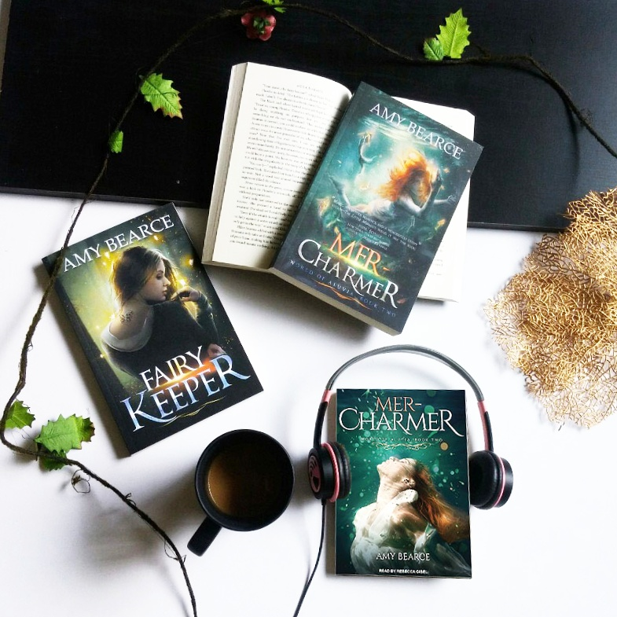
Shortcuts
The World of Aluvia series
The world of Aluvia is a place of magic, but it’s a broken, dark world. When the fairy queens disappear and their little fairies die, it marks the beginning of a long journey for three girls who seek to heal their world, including fairies, mermaids, and dragons.
When a new student arrives with a mysteriously tragic past, happy-go-lucky Parker tries to turn heartbreak to happiness like she always does, helping and manipulating situations, but she only makes matters worse when her psychic power goes haywire and threatens to expose dangerous secrets… starting with her own.
Notes:
Sierra hates being a fairy keeper, but when the fairy queens mysteriously vanish, she will stop at nothing to find them. Losing her queen wasn't supposed to threaten everything Sierra loved, but finding the missing fairies will risk more than she thought possible

Slide 8
Paris on Repeat (July 2020)

Slide 9
Do you consider yourself to be a writer or want to be one?
Do you consider yourself a reader?

Slide 10
3 Questions you’ll be able to answer after today!
What’s the writing process like?
What do writers *do*?
How does the publishing process work?

Slide 11
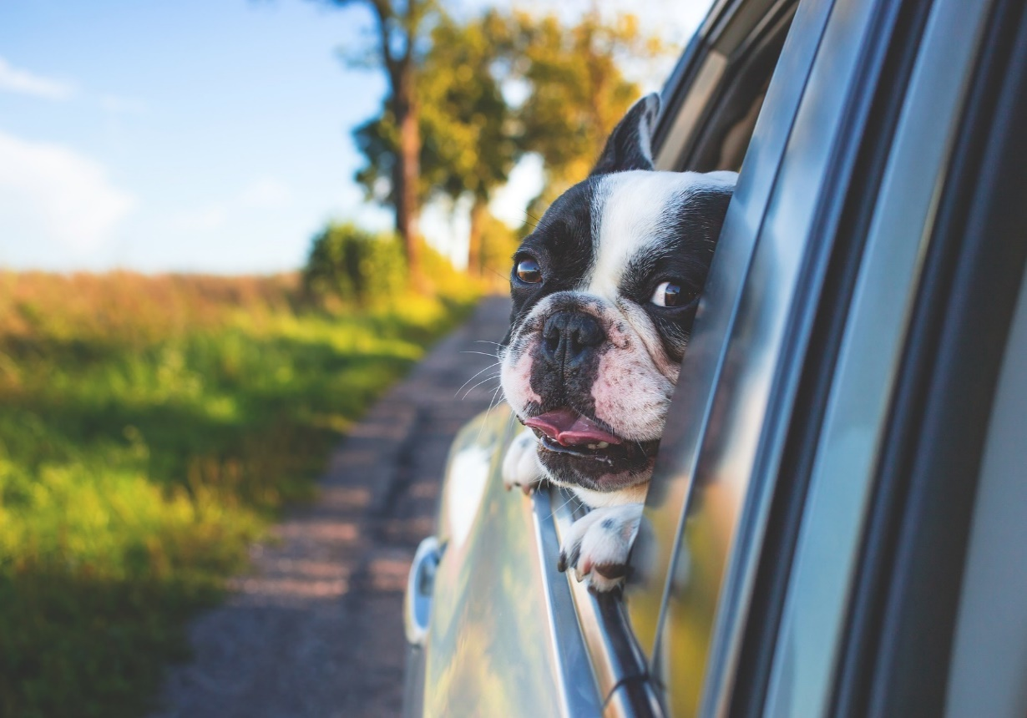
Writing a book is…
Notes:
My current focus on writing fo rme began about 9 years ago. I joined SCBWI in 2008. Started attending writing conferences, which changed my whole life. It also changed my definition of what a “successful writer looked like.” map image and David Marcu’s road image

Slide 12
Writing a book…IS MESSY!
Notes:
Fairy Keeper is my 5th completed manuscript. Success can take a long time. Driving in fog, by Thomasz Zagorski or the one by Jay Mantri Writing a novel is like driving a car at night. You can only see as far as your headlights, but you can make the whole trip that way. – E. L. Doctorow

Slide 13
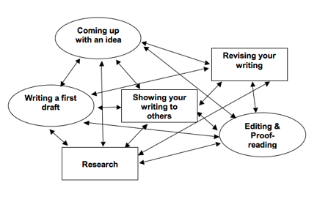
The Writing Process is Messy
Prewriting
Drafting
Revising
Editing
Copy edits/Proofreading
Publishing
Notes:
The Writing Process– the overview

Slide 14
Some writing terms to know:
Manuscript The craft of writing Critique
Publishing company/ press

Slide 15
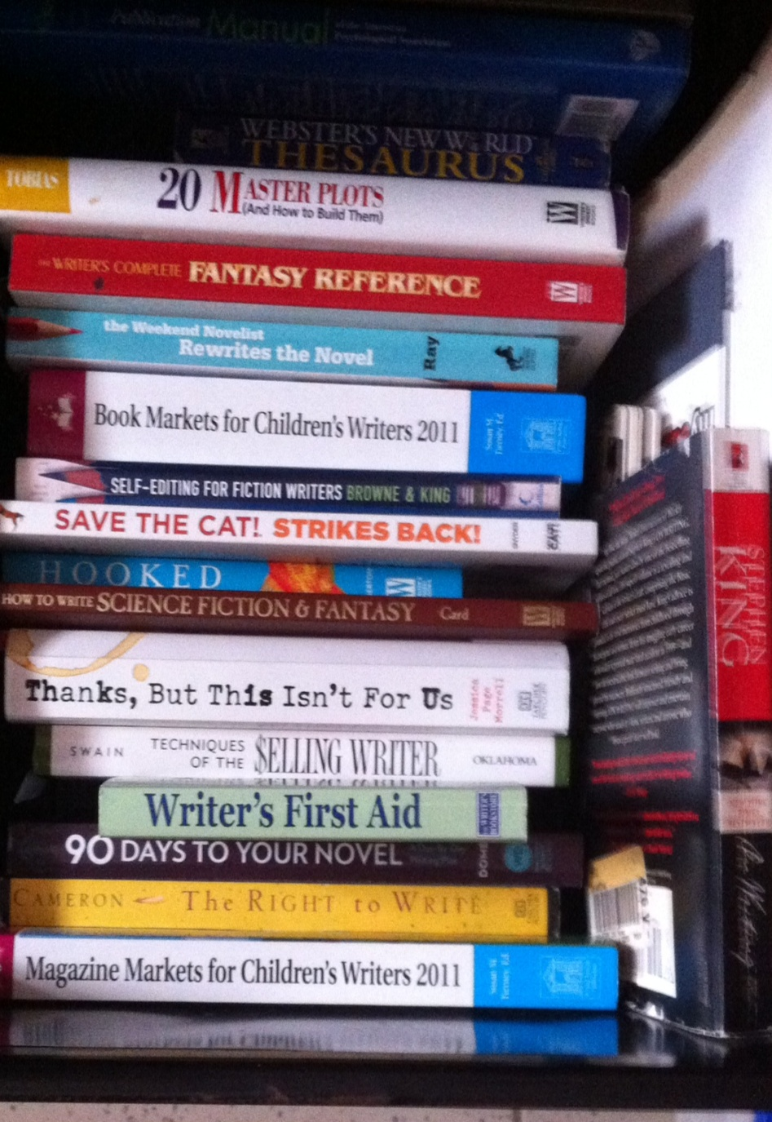
Writers are still learning, too!
#1! Read a LOT. ☺
Write a lot.
Read about writing.
Go to conferences, webinars, classes
Join writing communities
Join Critique groups
Notes:
#2

Slide 16
How do people write books?
Notes:
Drafting– three types of writers. I was a panster in the beginning. Writing short stories, it just made more sense to try it out and toss it if it didn’t work. But after three full length manuscripts had big problems due to lack of planning, I changed my methods. But it still works for many famous authors, like Stephen King. I’m a combo, though– Micah is a character who was not in my initial plans, but appeared rather suddenly when I was drafting my first version.

Slide 17
How do people write books?
There are as many different ways to write as there are writers.
I can tell you what others have shared with me and what I know for myself.
Notes:
Drafting– three types of writers. I was a panster in the beginning. Writing short stories, it just made more sense to try it out and toss it if it didn’t work. But after three full length manuscripts had big problems due to lack of planning, I changed my methods. But it still works for many famous authors, like Stephen King. I’m a combo, though– Micah is a character who was not in my initial plans, but appeared rather suddenly when I was drafting my first version.

Slide 18
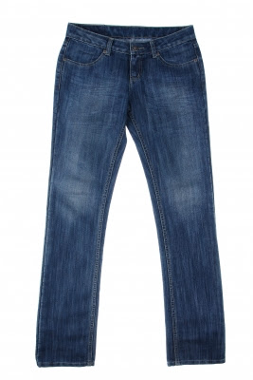
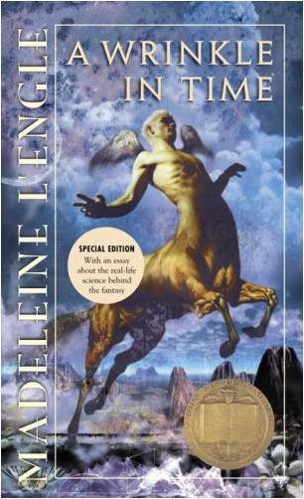
How do you write your books?
Pantsters
Notes:
Drafting– three types of writers. I was a panster in the beginning. Writing short stories, it just made more sense to try it out and toss it if it didn’t work. But after three full length manuscripts had big problems due to lack of planning, I changed my methods. But it still works for many famous authors, like Stephen King. I’m a combo, though– Micah is a character who was not in my initial plans, but appeared rather suddenly when I was drafting my first version.

Slide 19
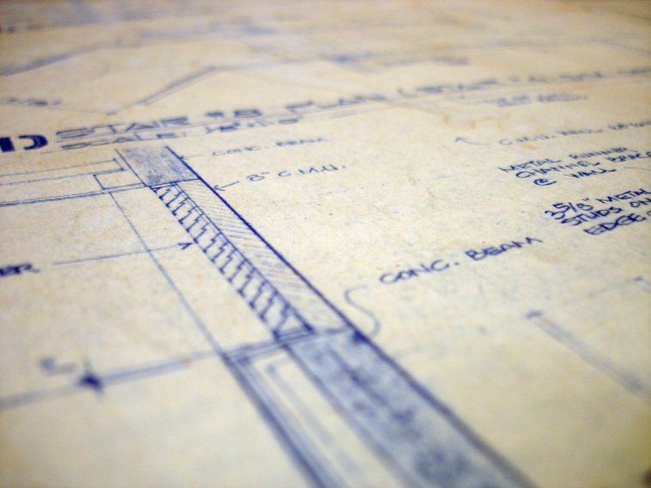
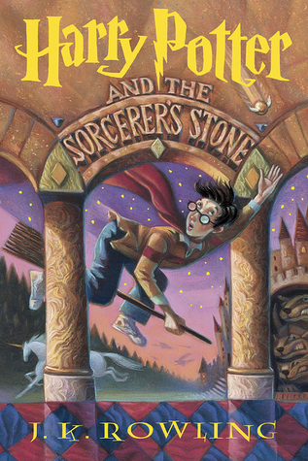
How do you write your books?
Pantsters
Plotters
Notes:
Drafting– three types of writers. I was a panster in the beginning. Writing short stories, it just made more sense to try it out and toss it if it didn’t work. But after three full length manuscripts had big problems due to lack of planning, I changed my methods. But it still works for many famous authors, like Stephen King. I’m a combo, though– Micah is a character who was not in my initial plans, but appeared rather suddenly when I was drafting my first version.

Slide 20
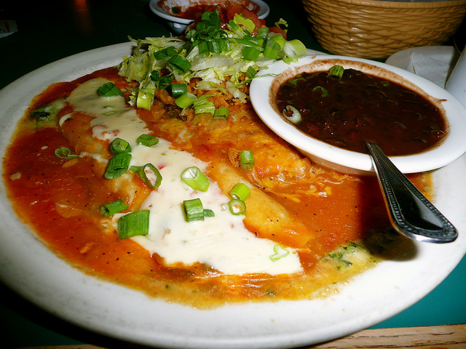
How do you write your books?
Pantsters
P
Plotters
Combo’s.
Notes:
Drafting– three types of writers. I was a panster in the beginning. Writing short stories, it just made more sense to try it out and toss it if it didn’t work. But after three full length manuscripts had big problems due to lack of planning, I changed my methods. But it still works for many famous authors, like Stephen King. I’m a combo, though– Micah is a character who was not in my initial plans, but appeared rather suddenly when I was drafting my first version.

Slide 21
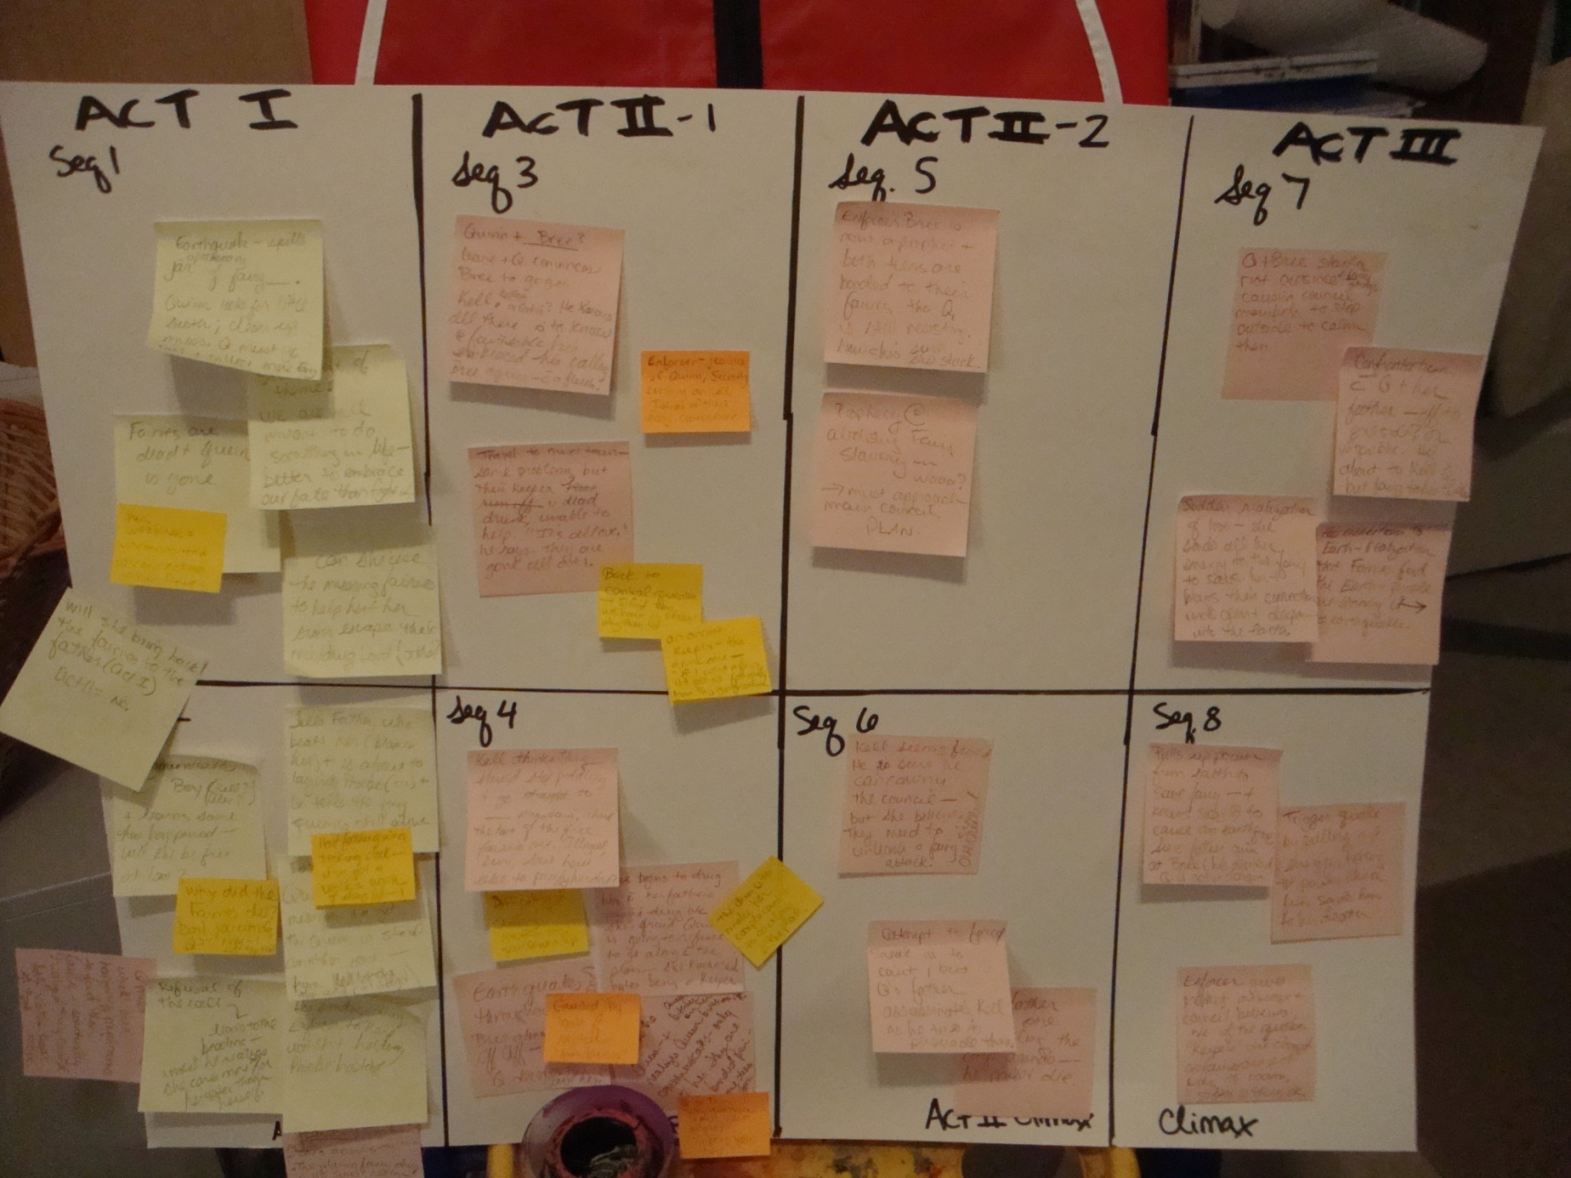
Prewriting with a story board
Notes:
PLOTTING Three act structure changed the way I wrote. I prewrite much more than I used to, and then when I draft, I am more efficient.

Slide 22
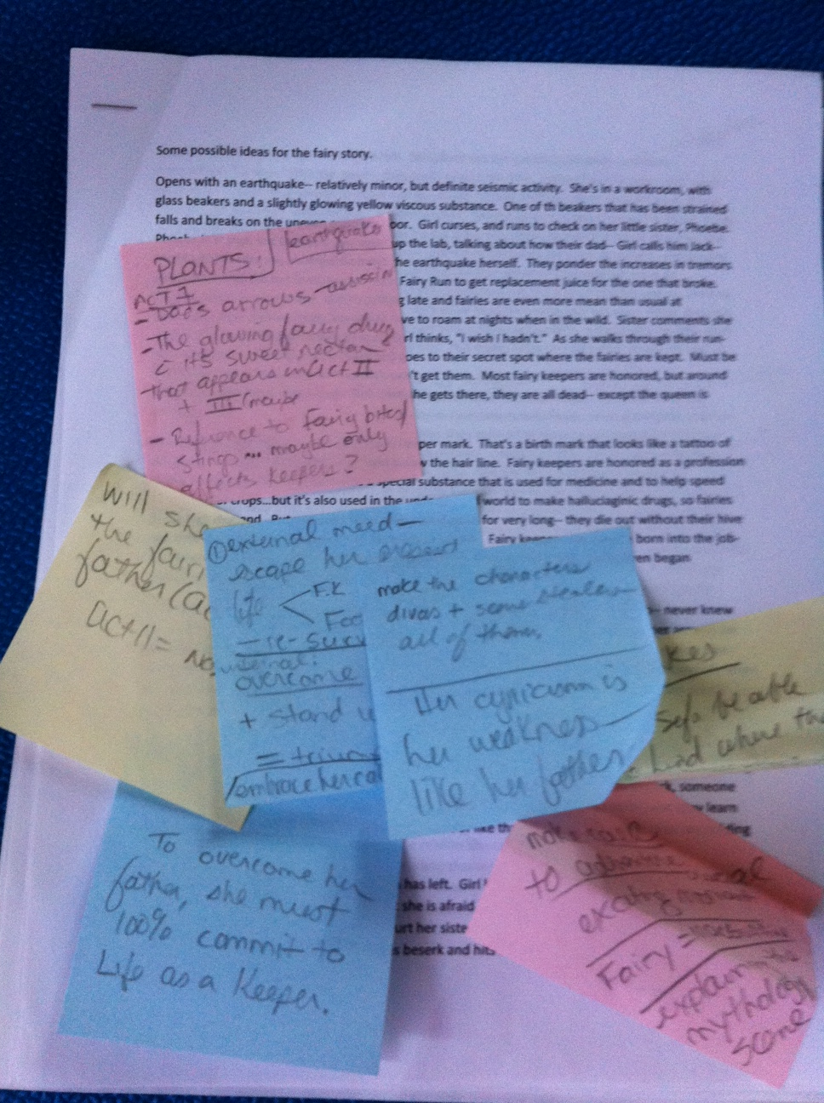
Prewriting- Try a synopsis Keep track of ideas with sticky notes
Notes:
Ways to brainstorm vary. I tried writing a pitch for the book before I wrote it. It worked better.

Slide 23
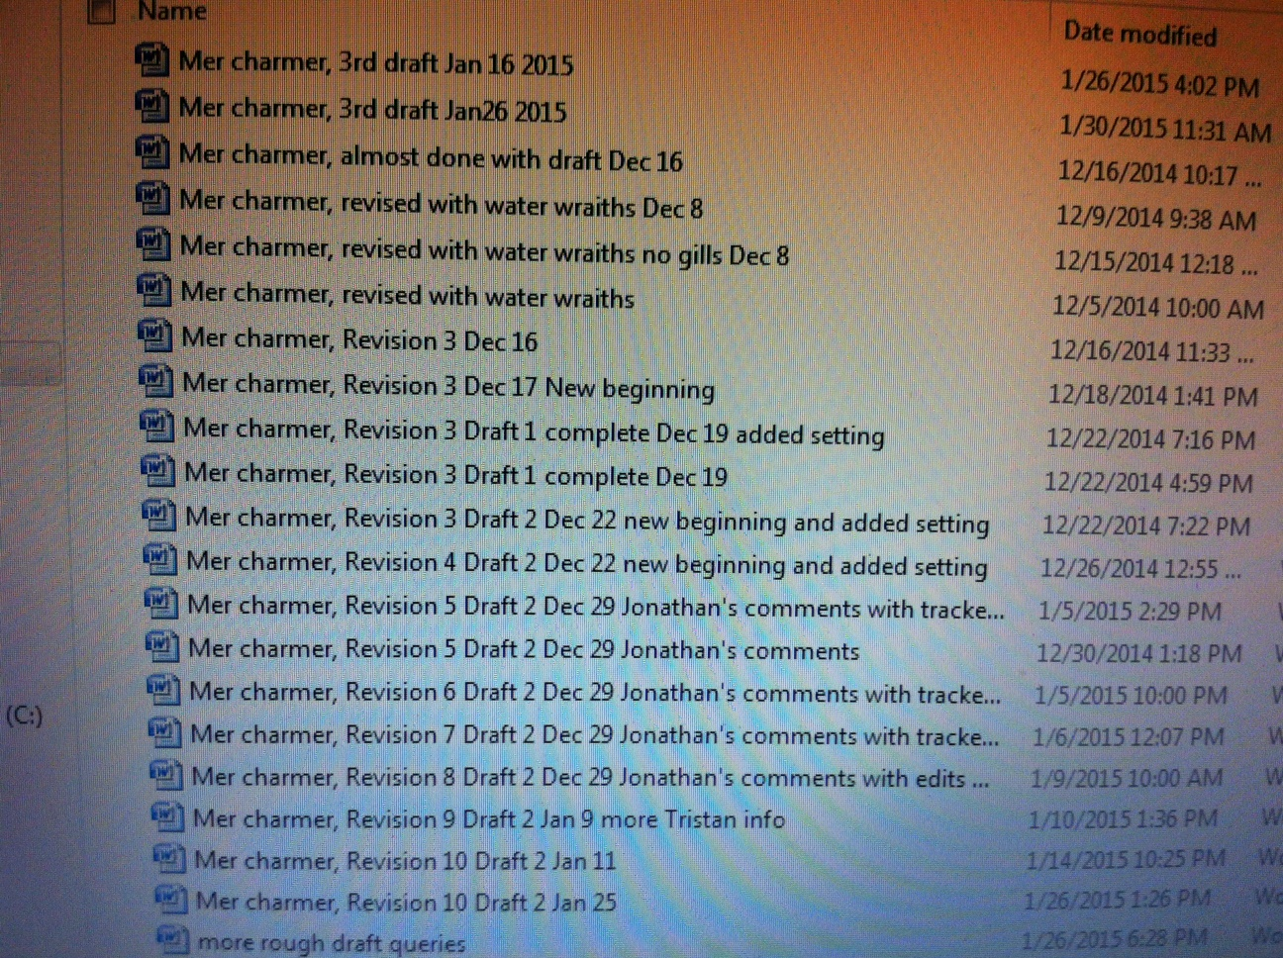
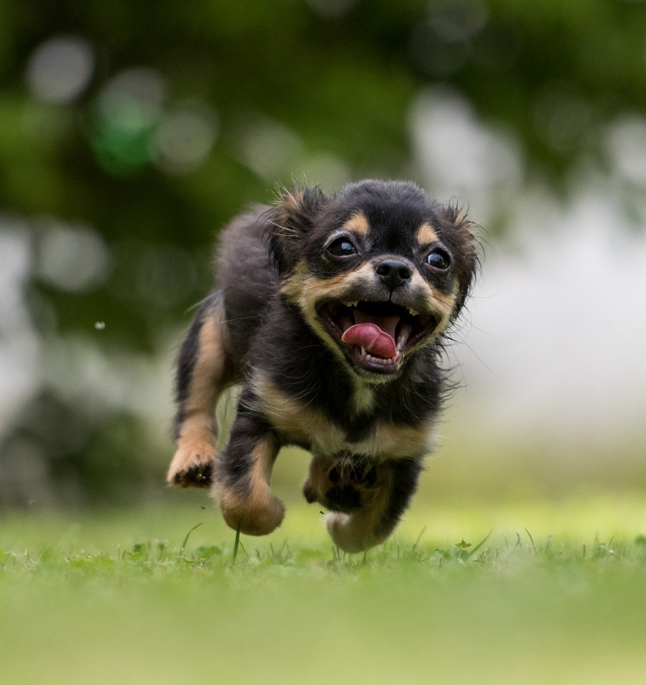
Drafting
GO, GO, GO! WRITE IT!
Notes:
Drafting– no wrong way to do it, as long as you DO IT> “Don’t judge– no one else has to see it!” -- Type everything, save everything…Many stick notes

Slide 24
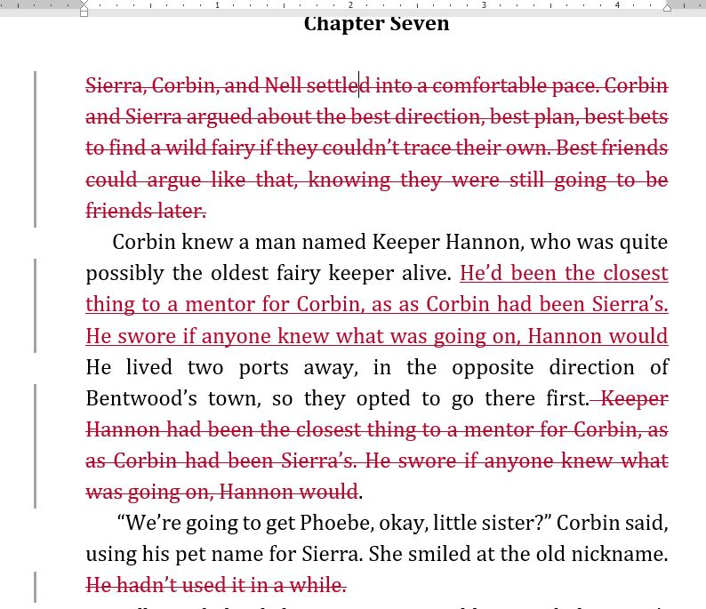
Revising: Writing IS rewriting.
Notes:
The CONTENT of the book actually changes, not just a word here or there. Entire last third act changed locations…twice.

Slide 25
The publishing process.
How long do you think it takes a book to get published once it’s under contract?
High/Low Guess
Notes:
QUERY– agent or no agent. Small press or big press. Query letters and how they work. T he story of how I got my publishign contract.

Slide 26
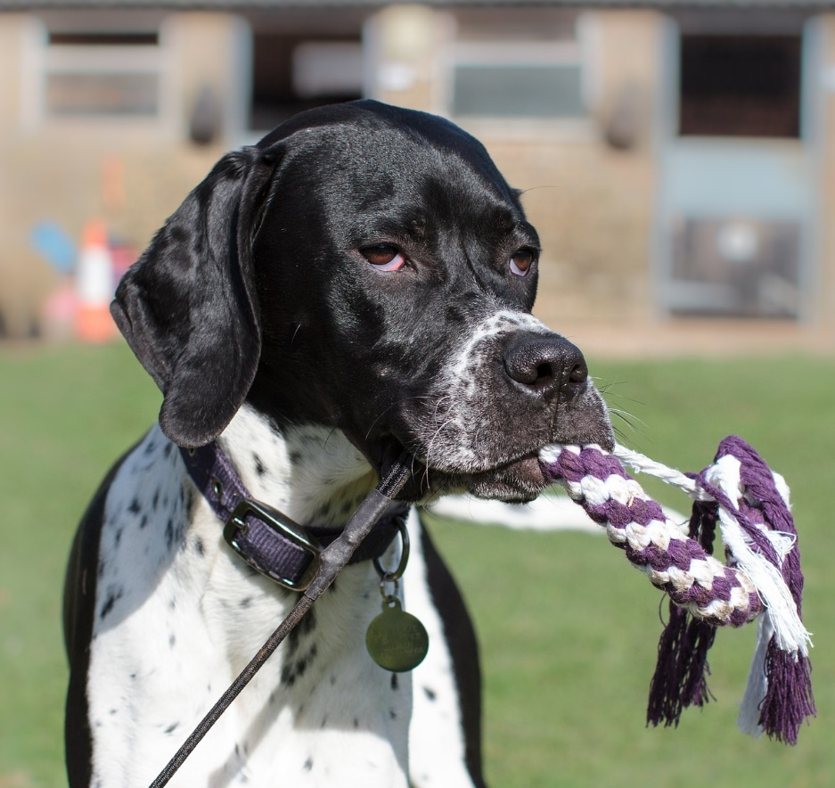
The publishing process takes a long time!
Are you kidding me?
books takes 1-2 years to be published! Sometimes even longer.
Notes:
I grew to hate my characters.

Slide 27
The Editorial Letter: sometimes a heart-breaker
Notes:
EVERY VERB AND PRONOUN changed in 82,000 words. “The ground growls beneath my feet and I freeze.” became, “The ground growled beneath Sierra’s feet and she froze.”

Slide 28
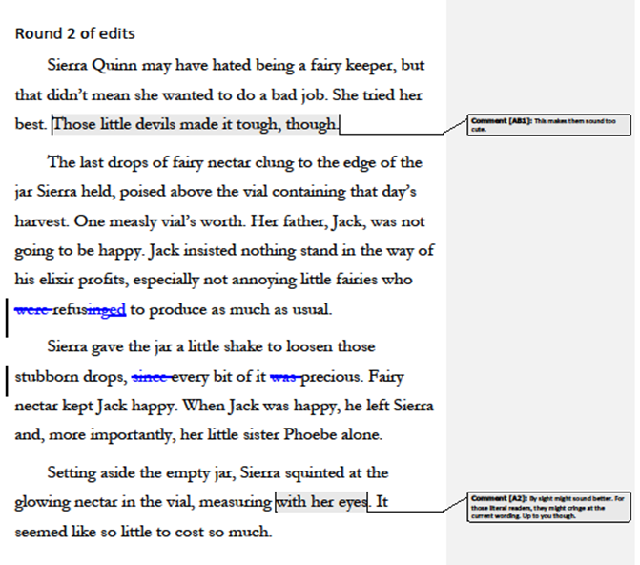
Rounds of Edits
1st round of edits = Editorial Letter
Round 2= Comments inside the document
Then Round 3, maybe,
= line edits.
Notes:
EDITORIAL NOTE– Heart attack. Major changes. POV. TENSE. YA to UPPER MG. My husband helped me world-build much better.

Slide 29
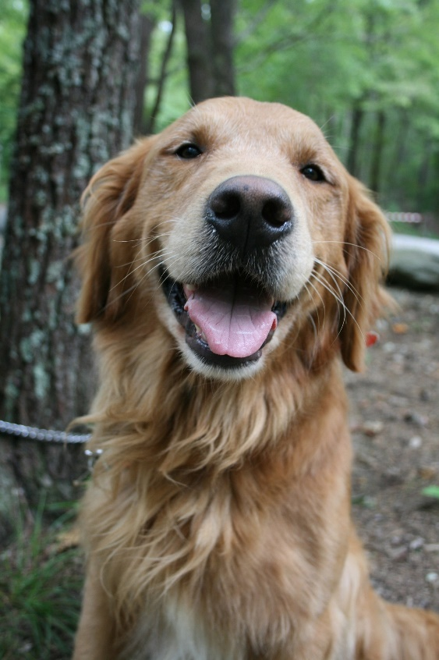
Proofreading Galley ARC’s (Advanced Reader Copies) Final copy goes to print! It’s REAL!
Final Steps
Happy day!
Notes:
Examples

Slide 30
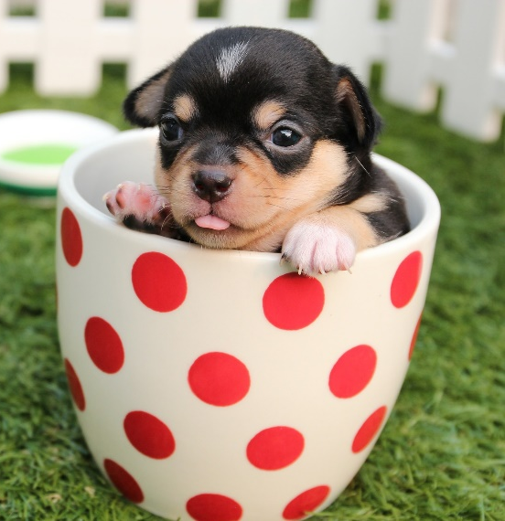
What are other things Authors Do?
How did I get here?

Slide 31
What are other things Authors Do?
How did I get here?
Speaking at conferences
Build Website
Social media
School Visits
Blog/newsletter
Plan Marketing
Ask for Reviews

Slide 32
The Inside Scoop about Covers
Who chooses the cover?
The author
The cover artist
The publisher
The readers
Notes:
Cover– happened after second round of edits

Slide 33
My Fairy Keeper cover “sketch”
Notes:
COVER HAPPENS around this time.

Slide 34
The “Full Wrap” Cover
Notes:
Real cover

Slide 35
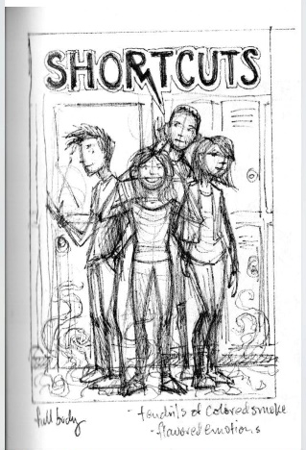
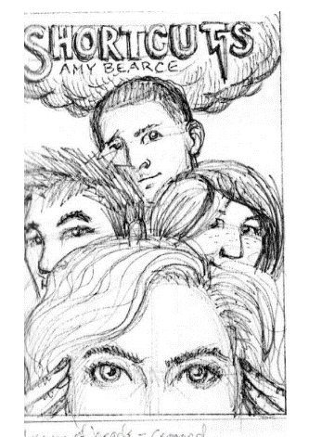
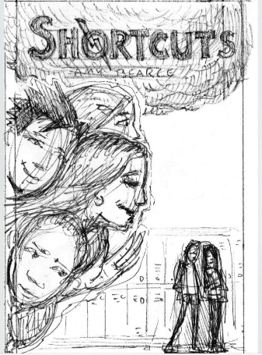
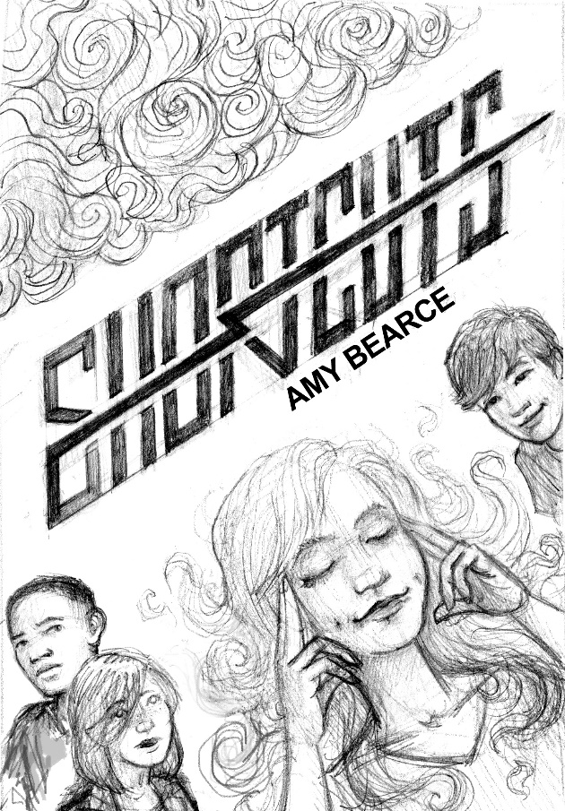
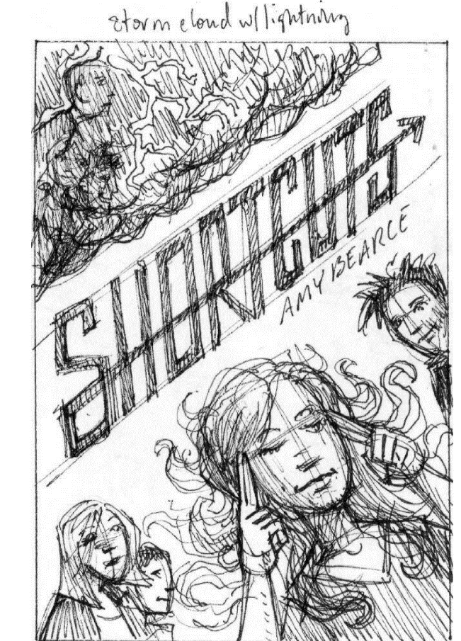
Covers Can Change
Original cover art by Jeff Crosby

Slide 36
Covers Can Change
Original cover art by Jeff Crosby

Slide 37
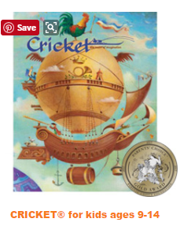
Want to be Published?
Some magazines to consider:
Stone Soup is for 13 and younger:
Cricket takes work from 14+
Highlights takes work from 16+
online. Younger people: snail mail.

Slide 38
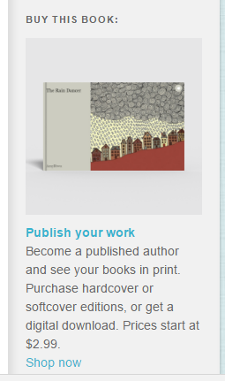
Other Options
For 1-2 copies of a book, you can use apps like Blurb or Storybird.
Keep an eye out for contests (PBS, Scholastic, etc)

Slide 39
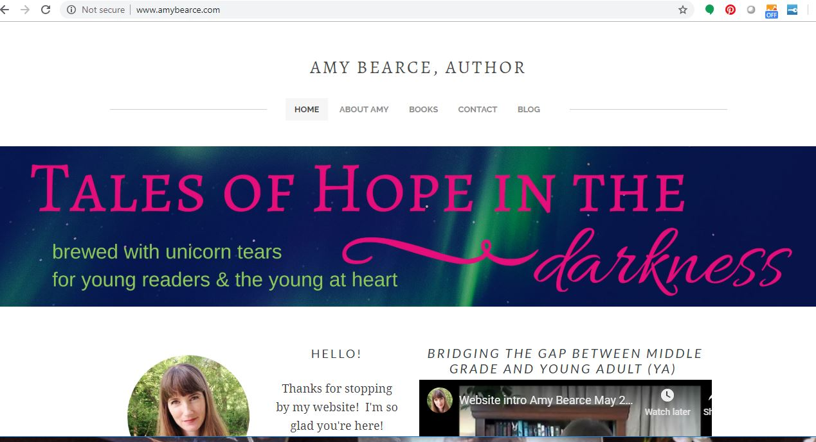
To learn more about my writing:
www.amybearce.com
Youtube * Goodreads * Amazon Author Page *Instagram* Twitter* Facebook

Slide 40
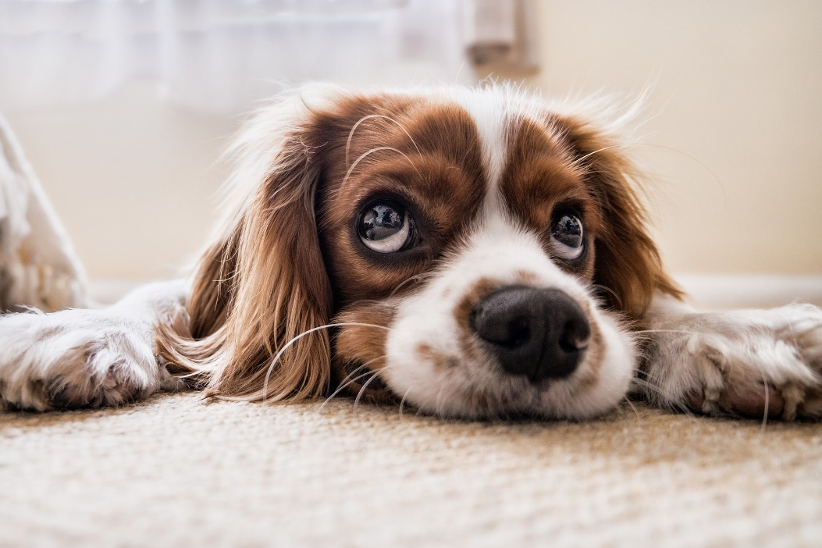
QUICK QUIZ (Don’t worry! Everyone wins!)
True or False:
A writer has to be born with a special talent.

Slide 41
QUICK QUIZ
True or False:
A writer has to be born with a special talent.
False! A writer is someone who works at their writing, who keeps at it, and is willing to learn. Everyone can learn to be a better writer.

Slide 42
QUICK QUIZ
True or False:
A writer spends all day alone at a desk, writing straight through until the story is done.

Slide 43
QUICK QUIZ
True or False:
A writer spends all day at a desk, writing straight through until the story is done.
False! Most writers stop and start on their stories, and they often get input from other people.

Slide 44
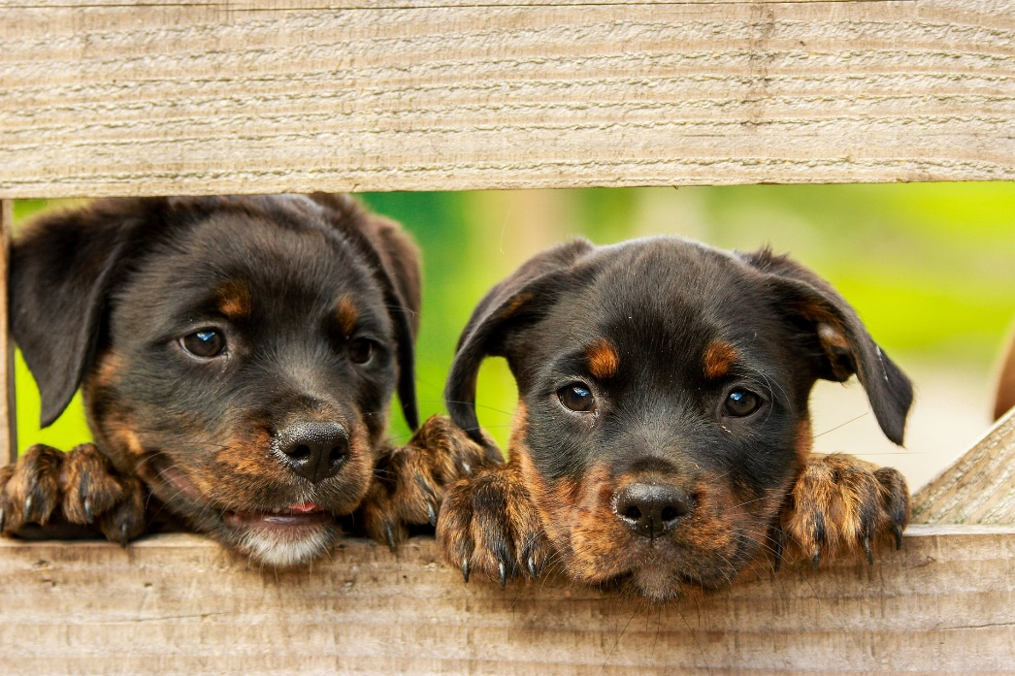
QUICK QUIZ
True or False:
A writer experiences a lot of rejection and must be willing to learn from others.

Slide 45
QUICK QUIZ
True or False:
A writer experiences a lot of rejection and must be willing to learn from others.
True! Publishing is a tough business, and authors are often rejected many times.
Notes:
Most writers are not rich, and can’t make a living income from their books alone.

Slide 46
Thank you!
Questions for me? Please ask! ☺

Slide 47
Q for you…
How do you decide what books to read next?
Do you have any favorite books or authors to share?
Do any of you use social
media? If so, what?

Slide 48
Some of my favorite MG Books

Slide 49
Some favorite upper MG books

Slide 50
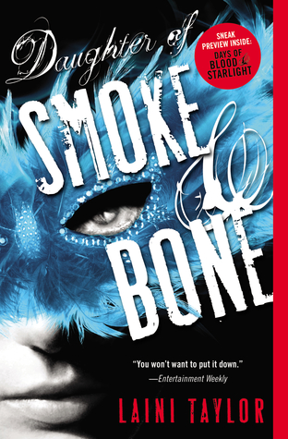
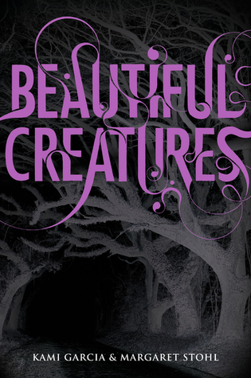
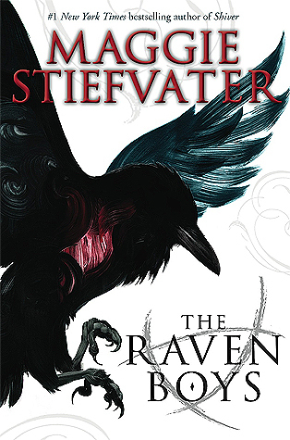
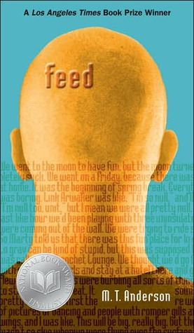
Some of my favorite YA books

Slide 51
Citations
Bm cmath. “image.” Morguefile. 2012. Accessed January 30, 2015. http://mrg.bz/jDDKxs
Rhoades, Marcella. Photos of Amy Bearce.1986-1987
Bearce, Amy. “Screenshot of Tweet.” 2014. Accessed January 31, 2015.
Bearce, Amy. Photos of Fairy Keeper brainstorming. 2011.
Chitulescu, Amalia. “Fairy Keeper cover design.” Curiosity Quills.2014.
Elemenoperica. “All_Kitty_Pics_135.” Morguefile. N.d. Accessed January 31, 2015. . http://mrg.bz/VWzTqT
Ferrer, Jayne Jaudon. “Contests for Teens.” http://www.jaynejaudonferrer.com/page/forstudents Accessed January 31, 2015.
“Girl with Fairy Tattoo” Google Images. Accessed March 2014.
Greyerbaby. “New Orleans.” Morguefile. 2013. Accessed January 31, 2015. http://mrg.bz/QvNcSr
Kamuelaboy. “DSC04857.” Morguefile. 2008. Accessed January 31, 2014. http://mrg.bz/xlHJWF (blueprints)
Krause, Steven. “Why Write Research Projects?” 2007. Microsoft Clip Art. “Question Marks.” Accessed January 30, 2015. http://www.stevendkrause.com/tprw/introduction.html Accessed January 31, 2015. (real depiction of writing process.)
McGuire, Ryan. “Untitled.“ Gratisography. N.d. Accessed January 30, 2014. (long stretch of empty highway.)
Microsoft Clip Art. “Stack of books.” Accessed January 30, 2015.
Microsoft Clip Art. “Man head on desk.” Acessed January 31, 2015.
Microsoft Clip Art. “Jeans” Accessed January 31, 2015.
Microsoft Clip Art. “Combo platters.” Accessed January 31, 2015.
Microsoft Clip Art. “Writing.” Accessed January 30, 2015.
Pedrojperez. “IMG_2871.” Morguefile. 2013. Accessed January 31, 2015. http://mrg.bz/kqVNts
Zagorski, Thomasz. “Untitled.” Unsplash.com. N.d. Accessed January 30, 2015. (car driving in fog) https://unsplash.imgix.net/photo-1417354691640-148c3d652342?q=75&fm=jpg&s=ce859d5eeab01289d6d48478559ab4e2

