Slide 1
Unlocking Your Story
By Amy Bearce

Slide 2
About Amy
I’m a military kid, a mom of two girls and a wife, and a former teacher.
I have three books out (originally with Curiosity Quills Press, now with Snowy Wings) and one with CBAY Books.
I’ve wanted to be a writer since I was in 5th grade, but lost my way. I wish someone had told me to stick with it. So that’s why I’m here.
Notes:
Having your character think about their stuff and never do anything…you must have conflict. having everything happen TO your character (can be done– but be careful, like Hitchhiker’s Guide to the Galaxy) … looking into a mirror to describe them…starting with your story waking up.

Slide 3
My Writing Experience
I began writing in 5th grade.
I taught 6th-8th grade writing and reading.
I wrote short stories and articles for standardized testing companies for 10+ years. I’ve sold over 350 pieces to over 20 different state projects.
I began writing book-length stories 9 years ago. My first book came out in 2015.
Notes:
Having your character think about their stuff and never do anything…you must have conflict. having everything happen TO your character (can be done– but be careful, like Hitchhiker’s Guide to the Galaxy) … looking into a mirror to describe them…starting with your story waking up.

Slide 4
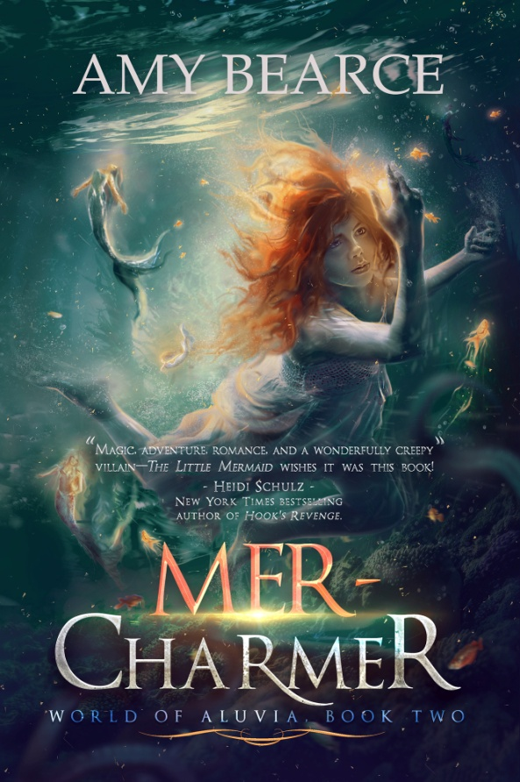
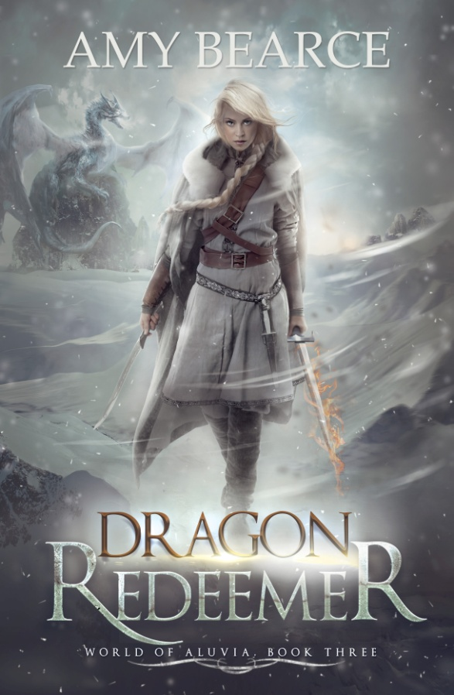
My Published Books
Notes:
Plus, I have a fourth book under contract, not a part of this series. “A fun-loving ninth grade girl with a secret gift of empathy tries to turn heartbreak to happiness for a new depressed friend, but makes matters worse when her psychic power goes out of control, threatening to expose more secrets than just her own.”

Slide 5
The World of Aluvia series
The world of Aluvia is a place of magic, but it’s a broken, dark world where magical creatures are suffering, and the land itself begins to shake apart. When the fairy queens disappear and their little fairies die, it marks the beginning of a long journey for three girls who seek to heal their world.
Sierra hates her calling as a fairy keeper, but is compelled to travel to the dangerous wilderness to find the lost queens.
Phoebe must help the gentle merfolk reclaim their magic once more—by first discovering her own.
And Nell must hold the line when a new enemy arrives who wants to return Aluvia to the days when humans held all the power, risking the very magic they’ve worked so hard to restore
.

Slide 6
SHORTCUTS
When psychic powers and secrets collide, no one is safe.
Parker Mills has it all. She's the two-time winner of the Miss Divine Pecan Pageant, head of the 8th grade dance committee, and a secret psychic empath. Since she absorbs strong emotions from those around her, Parker has committed herself to finding shortcuts to happiness. Whether acting as a tutor, coach, or matchmaker, Parker knows that when others are happy, she's happy. Granted, all that fixing other people's drama means her own crush has no idea how she feels, but it's still a win-win so long as her psychic method remains a mystery. At least, that's how it always worked until Mia came to town. With her mysterious past and dark cloud of depression, Mia's moods threaten to rain on Parker’s happiness parade. After Parker's usual shortcuts fail-- even after bringing gorgeous Josh on the scene--she's forced to kick things up a notch, or two. But when Parker's psychic power goes haywire, dangerous secrets unravel... starting with her own.

Slide 7
Ways to Share Your Writing:
Magazines: Stone Soup, Cricket, Highlights
Contests– PBS Kids, Scholastic
School newspapers/community papers
Blurb/StoryBird to make as gifts
WattPad
Treat class assignments as opportunities
Notes:
Get your 10,000 hours in. Stephen King had a STAKE, not even a nail, that he put all his rejections on.

Slide 8
Discovering Ideas:
Notes:
But to sell or publish a piece of writing, you have to have an idea first. THEY ARE ALL AROUND YOU. Colony Collapse Disorder.

Slide 9
Discovering Ideas
Boost your creativity– journaling, doodling, walking, mowing the lawn.
Notes:
My husband gets his ideas when he is underwater…swimming zones him out and his brain floats arounds…

Slide 10
Discovering Ideas
Boost your creativity– journaling, doodling, walking, mowing the lawn
Take a traditional tale and turn it on its head or change its location and timing.
Notes:
Let’s do an example… Maleficent is a story like that– we see the villain in a compassionate way. Same thing with Wicked. Set a tale in a different culture and time… There’s a book called 20 Plots because, really, the heart of many stories are similar. Lion King and Hamlet, for example, are much the same story. But they are also unique.

Slide 11
Discovering Ideas
Boost your creativity– journaling, doodling, walking, mowing the lawn
Take a traditional tale and turn it on its head
Ask “What if?”
Notes:
What if a girl had to take care of fairies and they all died? What if a girl loved mermaids more than anything and they didn’t trust her?

Slide 12
Discovering Ideas
Boost your creativity– journaling, doodling, walking, mowing the lawn
Take a traditional tale and turn it on its head
Ask “What if?”
Think back to your most vivid memories and consider ways to expand them.
Notes:
Many contemporary YA books are based on real-life experiences. Make sure it’s FICTION, though– don’t get sued.

Slide 13
Discovering Ideas
Boost your creativity– journaling, doodling, walking, mowing the lawn
Take a traditional tale and turn it on its head
Ask “What if?”
Think back to your most vivid memories and consider ways to expand them.
Keep a list of ideas, even if you think you’ll remember them.

Slide 14
Overcoming the Blank Page
Notes:
Now you have an idea…how to start fleshing it out. How to make yourself start writing, even if you only have a vague idea… that first blank page is hard to break into. You can start with a summary, an outline, a character description, a dialogue, a scene, an explanation…anything to get your brain focused on the story. And none of it has to be included in your final draft. (they prolly have NO IDEA how much you cut of what you write. Give examples..magical plague…etc.

Slide 15
Overcoming the Blank Page
Take your idea and write down thoughts about it. Give yourself permission to just ramble. Keep all of these notes.
Notes:
Now you have an idea…how to start fleshing it out. How to make yoruself start writing, even if you only have a vague idea… that first blank page is hard to break into. You can start with a summary, an outline, a character description, a dialogue, a scene, an explanation…anything to get your brain focused on the story. And none of it has to be included in your final draft.

Slide 16
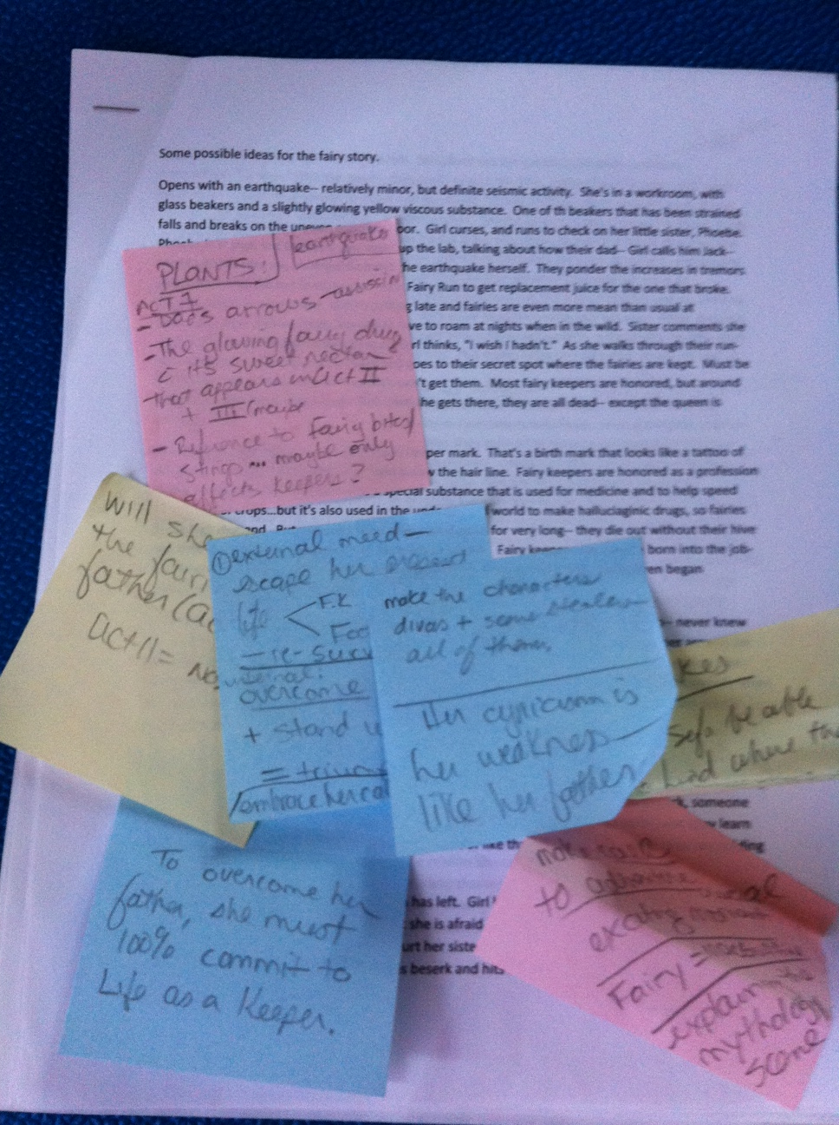
Overcoming the Blank Page
My summary
and notes
For a short story,
I start with a one
paragraph “pitch.”
Notes:
Now you have an idea…how to start fleshing it out. How to make yoruself start writing, even if you only have a vague idea… that first blank page is hard to break into. You can start with a summary, an outline, a character description, a dialogue, a scene, an explanation…anything to get your brain focused on the story. And none of it has to be included in your final draft.

Slide 17
Overcoming the Blank Page
Take your idea and write down thoughts about it. Give yourself permission to just ramble. Keep all of these notes.
Some plan out their story. Some just start writing. Any combination works for me.
Notes:
Now you have an idea…how to start fleshing it out. How to make yoruself start writing, even if you only have a vague idea… that first blank page is hard to break into. You can start with a summary, an outline, a character description, a dialogue, a scene, an explanation…anything to get your brain focused on the story.

Slide 18
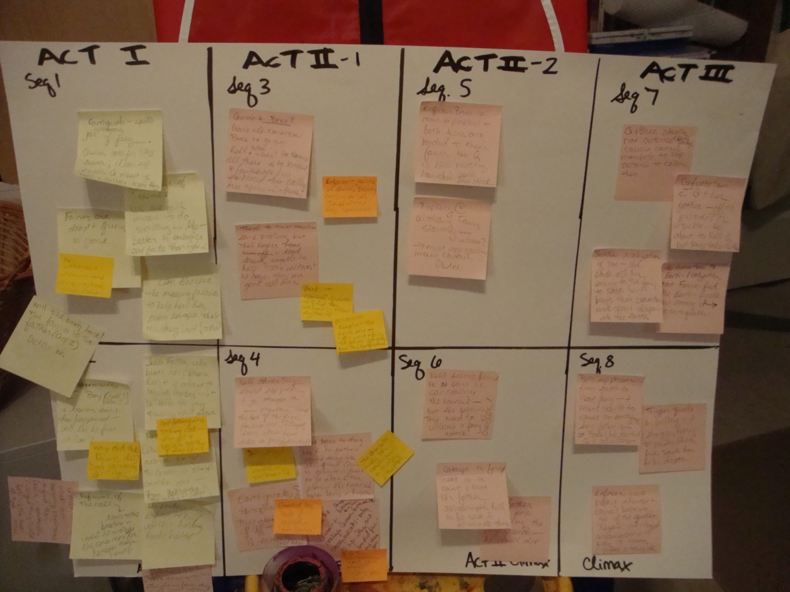
Overcoming the Blank Page
Ideas for planning:

Slide 19
Overcoming the Blank Page
Take your idea and write down thoughts about it. Give yourself permission to just ramble. Keep all of these notes.
Some plan out their story. Some just start writing. Any combination works for me.
Character sheets, character interviews

Slide 20
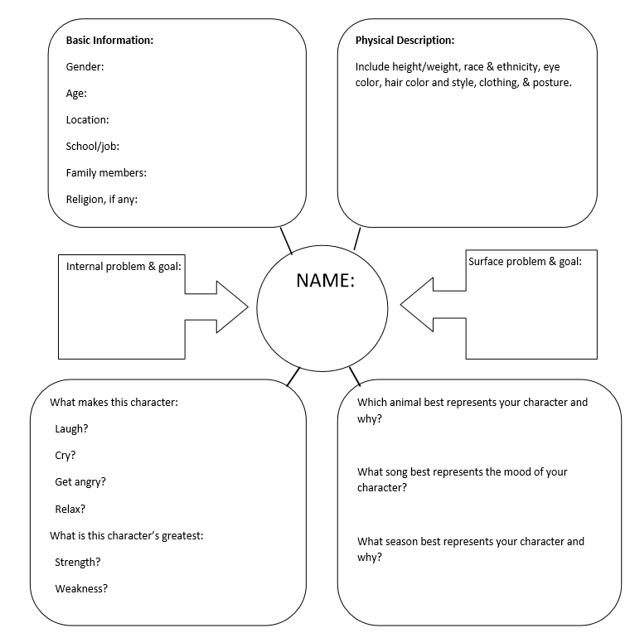
Overcoming the Blank Page
Character sheets, character interviews
Notes:
Include here a PDF image of a character sheet– or character interview page.

Slide 21
Overcoming the Blank Page
Take your idea and write down thoughts about it. Give yourself permission to just ramble. Keep all of these notes.
Some plan out their story. Some just start writing. Any combination works for me.
Character sheets, character interviews
Try telling a friend about it like you’re describing a movie.
Notes:
to get your brain focused on the story. And none of it has to be included in your final draft.

Slide 22
Start at the Right Place
Notes:
When you do start drafting the actual story… make sure you are starting at an interesting place> We really don’t need as much back story as you think.

Slide 23
Start at the Right Place
Opening scene and initiating event
(scene vs. summary)
Avoid “backstory.”
Let us care about your character before you put them in too dangerous of a place.
Notes:
When you do start drafting the actual story… make sure you are starting at an interesting place> We really don’t need as much backstory as you think.

Slide 24
Include KEY Information
Notes:
In the first few pages, we’ve got to learn a LOT. And if you are writing a short story, we’ve got to learn it even sooner.

Slide 25
Include KEY Information
Character
Setting
Tone/Mood
Problem (hint)
Notes:
Who is the MAIN character? Age? Human (could be an alien!), where is this story taking place, what mood/tone is happening, and what is the problem or hint of problem via what they need/want/dissatisfaction. If you can think of what your character wants and cannot have, you’ve got yourself a story to tell.

Slide 26
Include KEY Information
If we are confused on the first page, we may never finish your story. Let us see through your character’s eyes.
Notes:
Who is the MAIN character? Age? Human (could be an alien!), where is this story taking place, what mood/tone is happening, and what is the problem or hint of problem via what they need/want/dissatisfaction. If you can think of what your character wants and cannot have, you’ve got yourself a story to tell.

Slide 27
Keys to Good Writing
Notes:
Sensory. Active. Clear. Harder that it sounds, and it happens a lot during REWRITING

Slide 28
Keys to Good Writing
All drafts need revision. Don’t despair—expect that yours will, too!
Focus on:
Using sensory descriptions
Notes:
Sensory. Active. Clear. Harder that it sounds, and it happens a lot during REWRITING

Slide 29
Keys to Good Writing
Using sensory descriptions
“The pie was delicious.”
Vs.
“I reached for a second slice of pie, savoring the sweet tang of late-summer raspberries.”
“She looked angry.”
vs.
“Her scowling face was redder than the stop sign she’d just sped right past.”
Notes:
Sensory. Let’s do a practice one. “The room was messy.” SHOW ME THIS.

Slide 30
Keys to Good Writing
All drafts need revision. That’s okay!
Focus on:
Using sensory descriptions
Avoiding distancers: I saw/heard/felt
Notes:
Sensory. Active. Clear. Harder that it sounds, and it happens a lot during REWRITING

Slide 31
Keys to Good Writing
Avoiding distancers: I saw/heard/felt
I saw the bird as it soared across the sky, and heard it’s distant cry.
The mockingbird soared across the sky, its faint call carried away on the wind.
I watched Jill step into the room.
Jill stepped into the room.
Notes:
Do a search for see/hear/feel

Slide 32
Keys to Good Writing
All drafts need revision. That’s okay!
Focus on:
Using sensory descriptions
Avoiding distancers: I saw/heard/felt
Choosing active voice and strong verbs
-- avoid “very”
--exception: said. Stick with said.
Notes:
Sensory. Active. Clear. Harder that it sounds, and it happens a lot during REWRITING

Slide 33
Keys to Good Writing
All drafts need revision. That’s okay!
Focus on:
Using sensory descriptions
Avoiding distancers: I saw/heard/felt
Choosing active voice and strong verbs
Constructing clear sentences
Notes:
Sensory. Active. Clear. Harder that it sounds, and it happens a lot during REWRITING

Slide 34
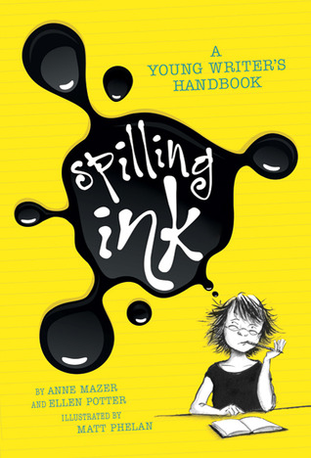
Keys to Good Writing
How to learn to write well?
Read a lot.
Write a lot.
Keep learning.
Read books on writing, take free webinars, receive good feedback & listen.
Notes:
Pixar has a free storytelling class right now on Khan Academy.

Slide 35
Pitfalls and Traps to Avoid
Notes:
DO NOT FREAK OUT. You can do this.

Slide 36
Pitfalls and Traps to Avoid
Include lots of conflict (scene and then sequel…and back with a new scene.)
Tell a deeper story (“More Than One Battle”)
Avoid clichés
Don’t have them look in a mirror to describe themselves.
Research if you need to. Don’t try to fake knowledge about things.
Notes:
Having your character think about their stuff and never do anything…you must have conflict. having everything happen TO your character (can be done– but be careful, like Hitchhiker’s Guide to the Galaxy) … looking into a mirror to describe them…starting with your story waking up.

Slide 37
Any Questions?
Every question is worthwhile to ask.

Slide 38
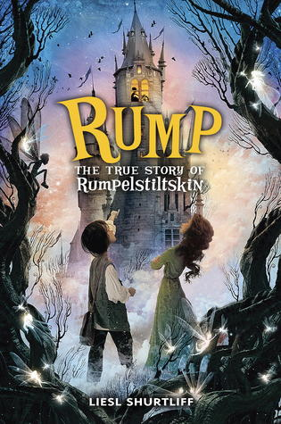
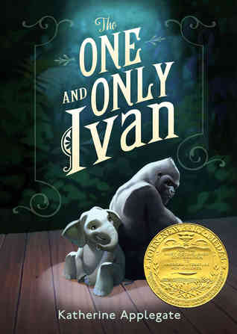
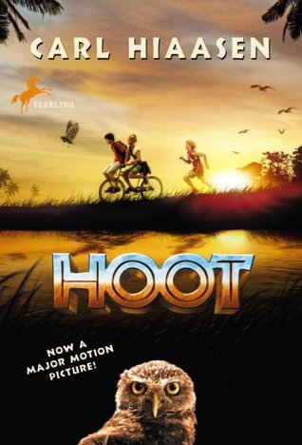
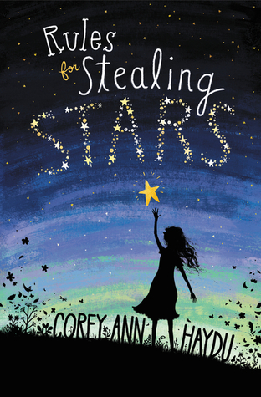
Some of my favorite MG Books

Slide 39
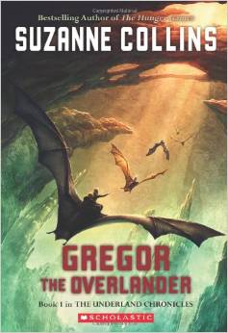
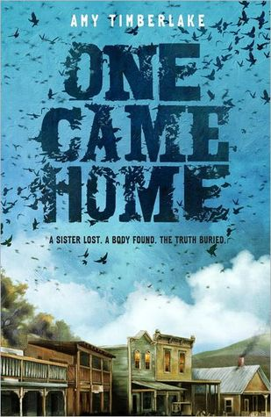
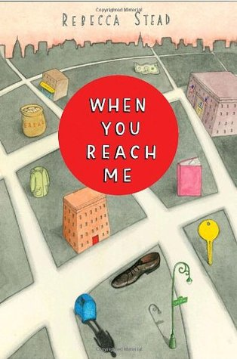
Some favorite upper MG books

Slide 40
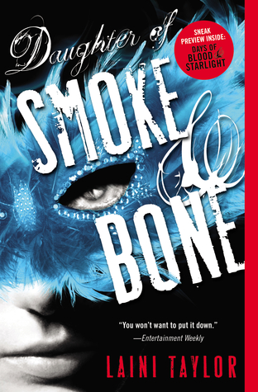
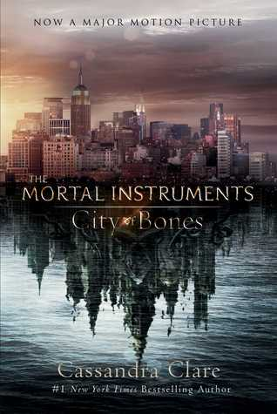
Some of my favorite YA books

Slide 41
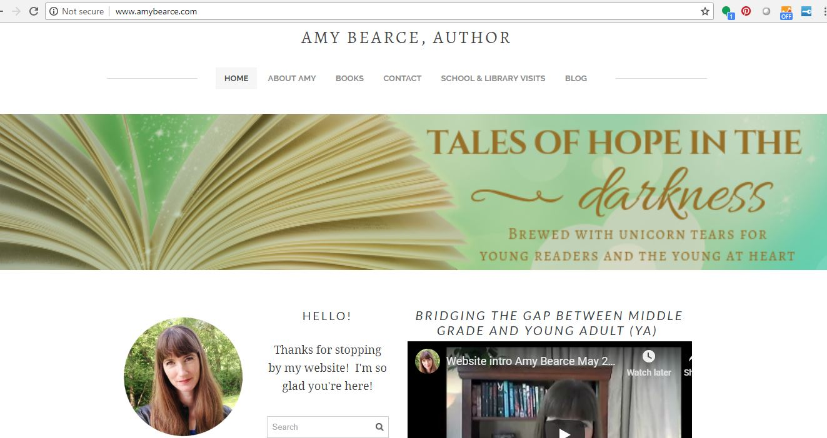
Thanks! Stay in touch!
www.amybearce.com
Instagram
Facebook
Twitter
YouTube

